Slide 1
From Risks to Results:
Uncovering the Real Costs of Poor Employee Health and Practical Solutions for Success
Guest Speaker: Jamie Humphrey CEO & Co-founder

Slide 2
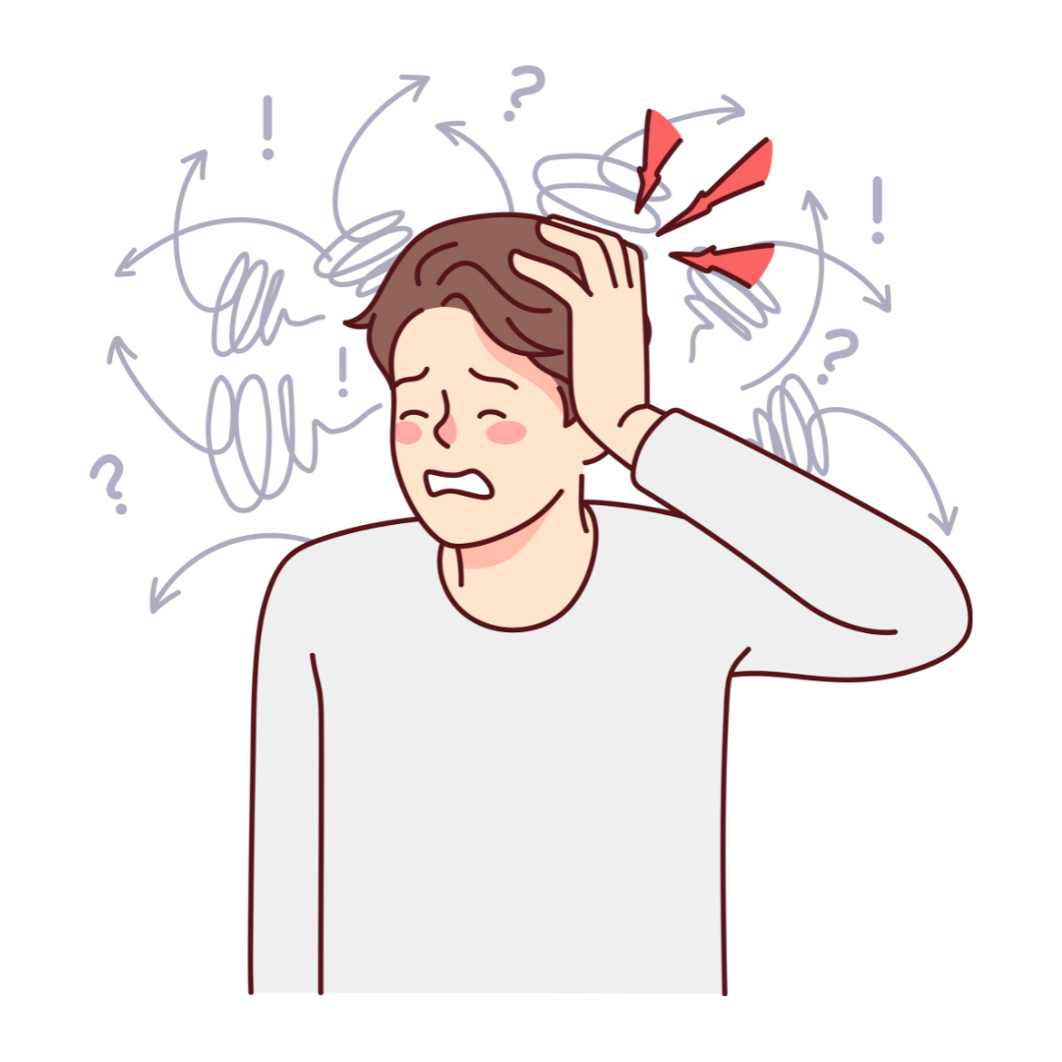
The Healthy Vs The Unhealthy
Employee
Lower Productivity
Struggling mentally
Frequent Absenteeism
Low Energy and Fatigue
Job Dissatisfaction
Higher Productivity
Mentally Strong
Minimal Absenteeism
Higher Energy Levels
Strong Job Satisfaction

Slide 3
60% of financial miscalculations in the workplace are due to human error, often stemming from fatigue and poor mental health (PwC, 2021).
The Unhealthy Employee & RISK
80% of workplace accidents are attributed to human error, often caused by fatigue, stress, or mental health challenges.
HSE 2023
33% of compliance failures are directly related to employee stress or disengagement, resulting in fines and legal issues.
CIPD 2022
60% of financial miscalculations in the workplace are due to human error, often stemming from fatigue and poor mental health.
PwC, 2021
85% of workplace errors and caused by miscommunication and misunderstandings, often caused by stress.
CMI 2020

Slide 4
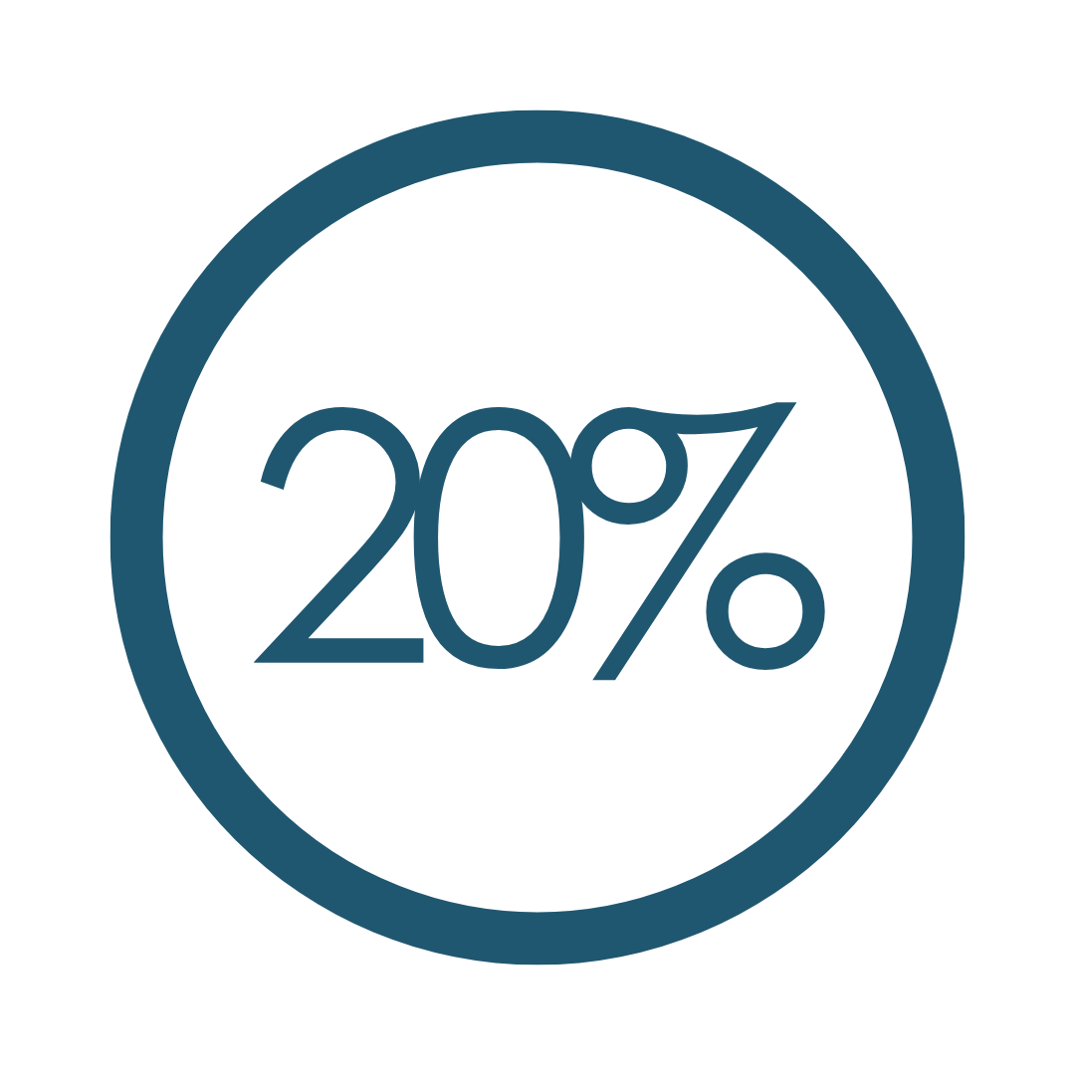
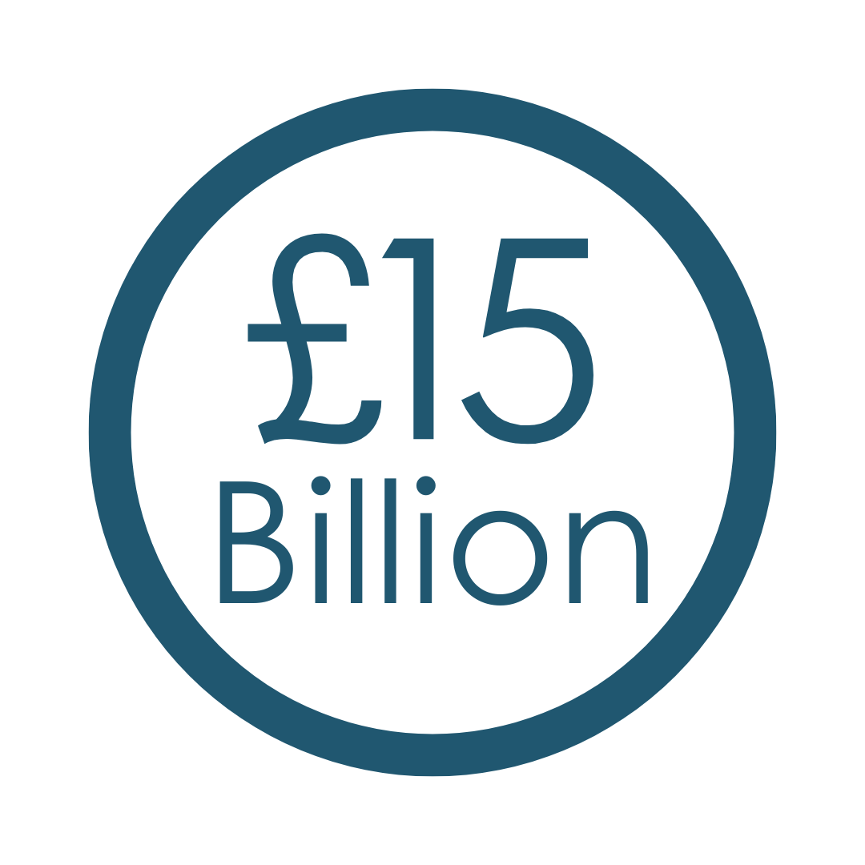
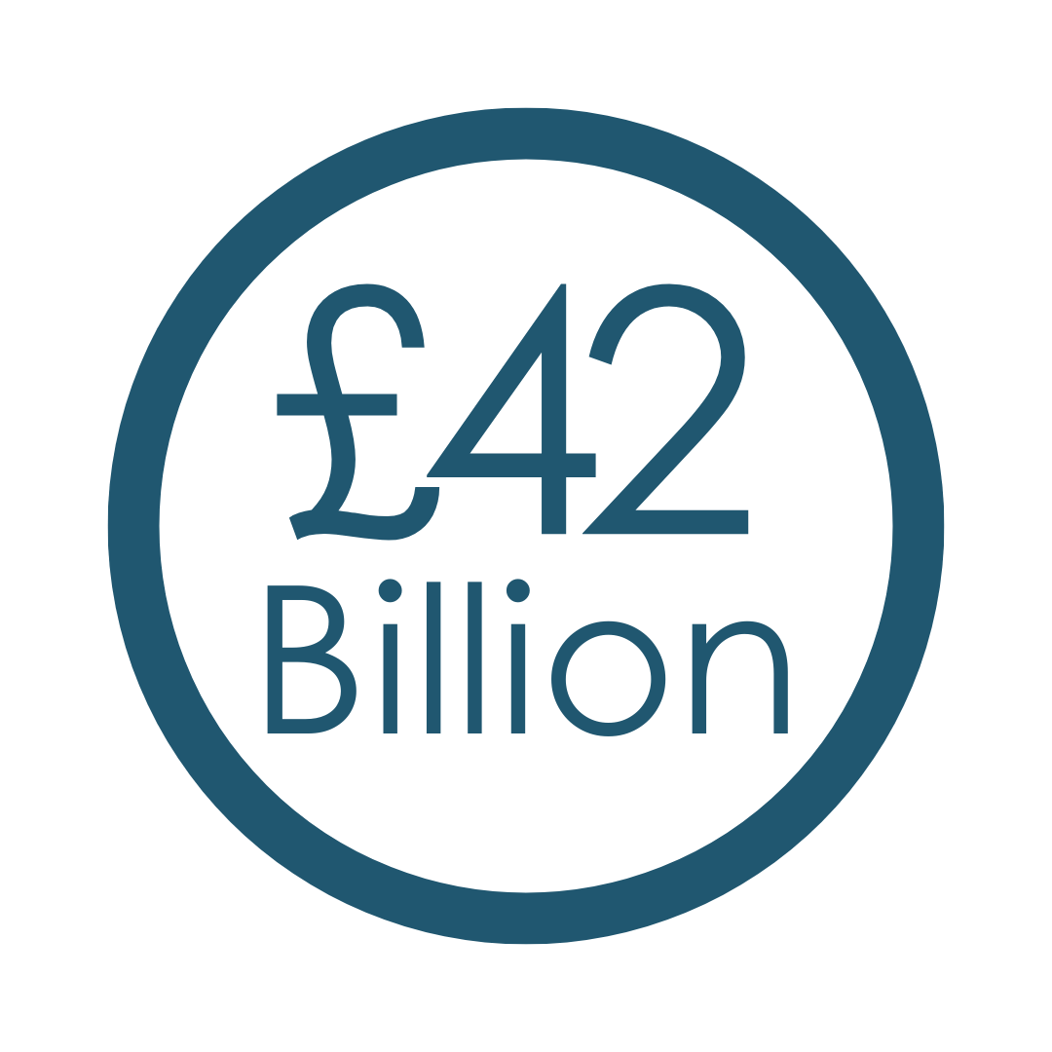
The Real Costs of Poor Employee Health
Of employees leave due to health-related issues
Cost of absence due to workplace-related ill-health
Cost of presenteeism due to workplace-related ill-health
CIPD 2023
UK Health and Safety Executive 2022
Deloitte 2020

Slide 5
Mental Health as a Major Driver of Costs
Stress, anxiety, and burnout are top contributors to reduced productivity, increased sick days, and higher turnover.
Cost of mental health to UK employers
Deloitte 2022

Slide 6
Case Study 1: Barclays Bank
Challenge: Rising costs associated with absence and presenteeism – linked to stress/mental ill-health
Solution: Implemented comprehensive wellbeing program:
MHFA
In-house counselling services
Ongoing wellbeing initiatives
Outcome: Reduction in absenteeism, 30% improvement in staff wellbeing and productivity. For every £1 invested, £5 return including lower absenteeism costs & higher engagement.

Slide 7
Case Study 2: Hobson’s Brewery
Challenge: Rising costs associated with absence and presenteeism, leading to problems with morale & productivity – linked to stress/mental ill-health
Solution: Implemented comprehensive wellbeing program:
MHFA & Mental Health Awareness Training
In-house counselling services
Ongoing wellbeing initiatives
Outcome: 25% reduction in absenteeism and improved workplace culture, with employees feeling more supported and engaged. The company saw an increase in productivity and a reduction in staff turnover

Slide 8
Common Mistakes
Not focusing on the environment & the employee
Reliance on Employee Assistance Programs
Choosing disengaged providers
No buy-in from the top
A reactive approach
Lack of Investment
A lack of data

Slide 9
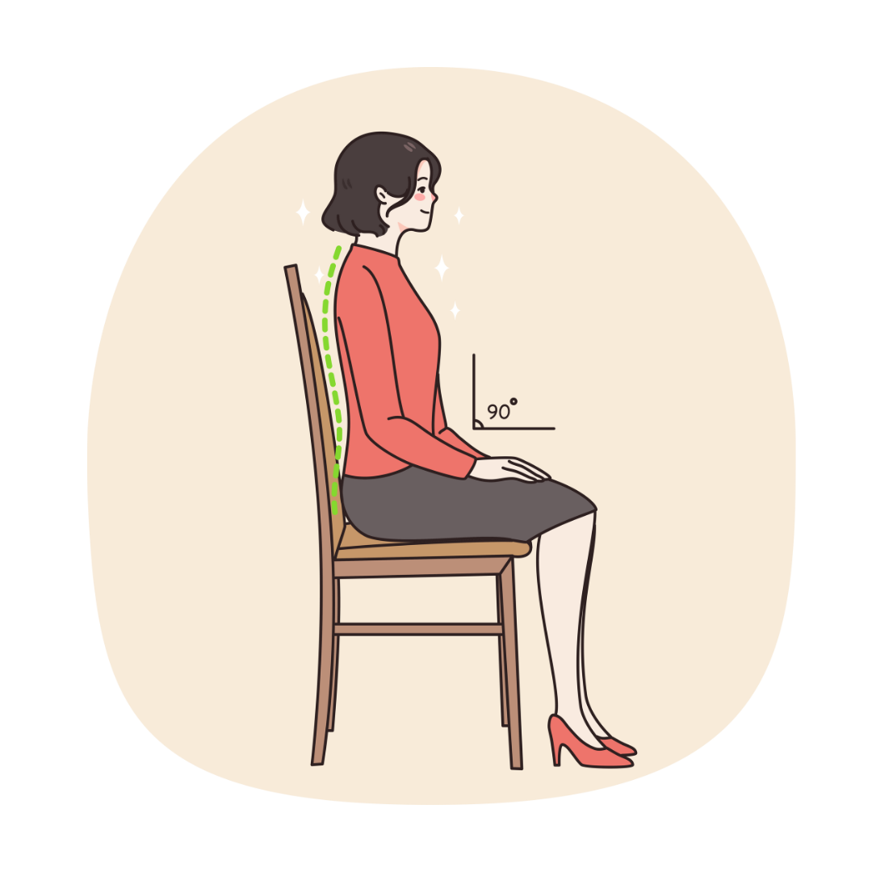
Solutions
A Healthy Environment
A Healthy Employee
Flexible Working Arrangements
Offer flexible hours, remote work options, and adaptable schedules.
Ergonomic Workspaces
Invest in ergonomic furniture, such as adjustable desks and chairs.
Inclusive Company Culture
Foster a culture where open communication and employee feedback are encouraged.
Breakout Spaces
Create dedicated spaces for relaxation or quiet work to allow employees to decompress, recharge, and stay focused.
Workload Management
Implement systems for managing workloads more effectively, ensuring employees aren’t overwhelmed and can maintain consistent performance.
Mental Health
Counselling services (NOT EAP), MHFA, Mental health awareness workshops, Culture of openness
Physical Health
Personal Trainer access, Exercise initiatives like cycle to work schemes, Fitness challenges, Gym discounts
Nutritional Health
Access to Nutritionists, Nutritional workshops, Discounts on healthy food
Financial Health
Access to Financial Coaches, Finance workshops, Salary advance schemes, Pension plans
Social Health
Team bonding days, Specialist counselling services, Social clubs, Mentorship programs

Slide 10
A COMPLETE SUPPORT TEAM
Therapist/Counsellors
Financial Coaches
Personal Trainers
Nutritionists
in the pocket of every employee

Slide 11
An Extension Of Your Team
Traditional Provider Approach
1. Provide Access
2. Run away
The Approach
1. Create an engagement target together
2. Run a full diagnostic on your existing wellbeing program
3. Deliver a custom ‘Live Launch’
4. Feedback usage monthly
5. Roundtable quarterly to discuss progress and plan for next quarter
6. Refer other services as needed – work shops, consultants etc

Slide 12
Any Questions? .
Disclaimer . Please note that the information contained in this presentation is provided for general informational purposes only. It does not constitute any form of legal or other professional advice, and you should not use it as a substitute for advice tailored to your specific circumstances.
We disclaim all and any liability for any actions you take (or omit to take) in reliance upon the contents of this presentation.
Our contact details are below should you wish us to contact us for professional advice.
Risk@kareneckstein.co.uk
07973627039
From Risks to Results:
Uncovering the Real Costs of Poor Employee Health and Practical Solutions for Success

