Slide 1
The risks of not knowing the numbers
Presented by Martin Mellor for The RiskBites ® Club​
11 June 2024

Slide 2
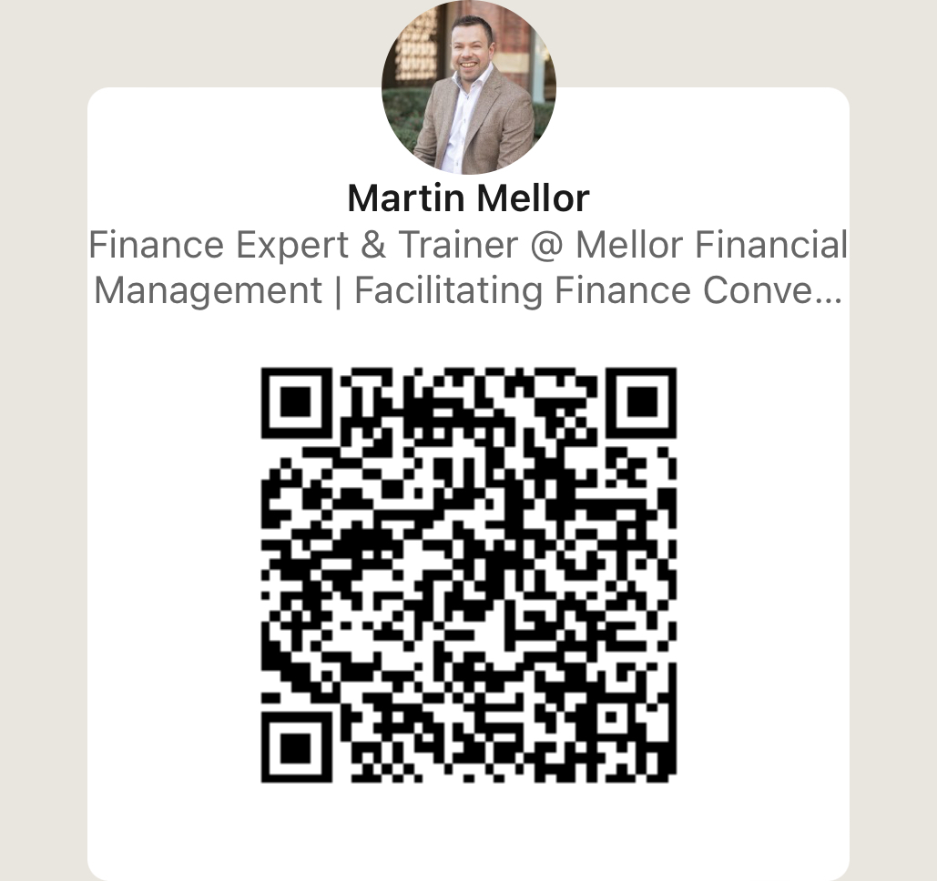
Who am I

Slide 3
Why don’t people know the numbers?
Language / Jargon
Lack of effective education
Culture / Fear
(Lack of or poor) Communication

Slide 4
A sense of scale
Business Failure
Operational
Low Value
High Value

Slide 5
Lack of Challenge
Lack of Control
Inaccurate Data
Lack of Focus
Ineffective Targets
Where the risk comes from

Slide 6
Ineffective Challenge
Stay Quiet
Don’t Question
Don’t interrogate
Don’t Investigate
Compound

Slide 7
Ineffective Control
Delegate Authority
Overspend
Wasted resource / Inefficiency
Fraud

Slide 8
Resource
Wrong amount
Wrong place
Wrong focus
Wrong outcomes

Slide 9
Focus
Is understanding of performance accurate?
Are the right strategies in place?
Are the right corrective actions in place?
Is there missed opportunity?

Slide 10
Targets
Do people understand WHAT is being asked of them?
Do people understand WHY that is being asked of them?
Do people understand the implications of not meeting targets?

Slide 11
Data
40% of a business’s data is either:
Missing
Wrong
Inaccurate

Slide 12
Missing or Inaccurate Data
Reduced Efficiency
Missed Opportunity
Lack of compliance
Over/under stated Revenue / Profit
Inaccurate Analysis
Reputational Damage
Data
£244 bn

Slide 13
Examine
Educate
Empower
Embrace
Employ
So what can we do?

Slide 14
So what can we do?
If you are interested in our courses I have various options:
Face To Face: https://mellorfinancialtraining.co.uk/upcoming/
Self Study: https://mellorfinancialmanagement.arlo.co/checkout
I’m also collating a waitlist to put together courses specific for the legal profession, anyone interested can sign up here:
https://www.waitlistr.com/lists/d840513d/making-finance-your-superpower
Here is a jargon download that I’m happy for you to share with all your members
https://mellorfinancialtraining.co.uk/jargon-buster/

Slide 15
The risks of not knowing the numbers Any Questions?
Disclaimer . Please note that the information contained in this presentation is provided for general informational purposes only. It does not constitute any form of legal or other professional advice, and you should not use it as a substitute for advice tailored to your specific circumstances.
We disclaim all and any liability for any actions you take (or omit to take) in reliance upon the contents of this presentation.
Our contact details are below should you wish us to contact us for professional advice.
Risk@kareneckstein.co.uk-07973627039
Karen Eckstein
LLB, CTA, Cert IRM

