Slide 1
Cyber Risks A discussion for the RiskBites ® Club
Presented by Dan Gladstone
11 April 2023

Slide 2
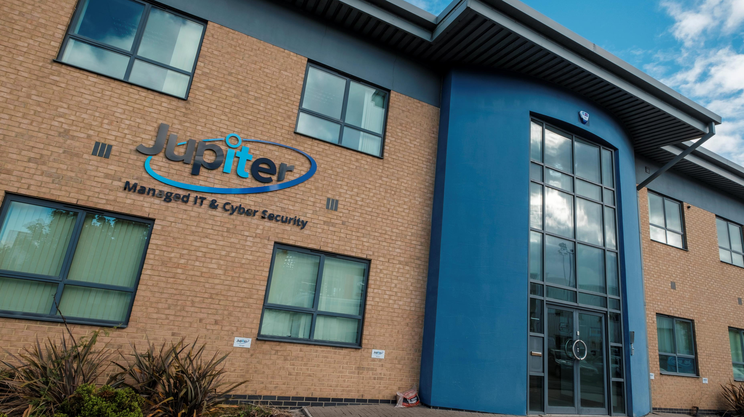
Protecting Your Assets

Slide 3
Who we are.
Proactive Managed IT Support Provider
Cyber Security Specialists
Years of Business

Slide 4
Topics Covered
Why is Cyber Crime growing at such an alarming rate?
How do businesses lose money to crime?
What types of businesses are at risk?
What are the types of threats to businesses?
What can businesses do to limit the risk?
What is the Cyber Essentials scheme?
How does the Cyber Essential scheme relate to risk management?

Slide 5
Questions? Daniel@jupiterit.co.uk

Slide 6
Cyber Risks A discussion for the RiskBites ® Club

